Slide 1

PROJECT NAME:
DESIGN AN AUTONOMOUS ROBOT FOR INDOOR NAVIGATION USING A* SEARCH FOR PATH PLANNING WHILE AVOIDING OBSTACLES . EQUIPPED WITH SENSORS IT DYNAMICALLY UPDATES ITS ENVIRONMENT KNOWLEDGE ENSURING REAL TIME PATH ADJUSTMENTS
GROUP NO 6
GROUP MEMBERS
  AHMED ZULKAR NAYEEN - 2121592642
  NUSRAT JAHAN RIMA-2122210642
  SANJIDUL ISLAM-2022394642
  AKASH MITRA-2011375042

Slide 2
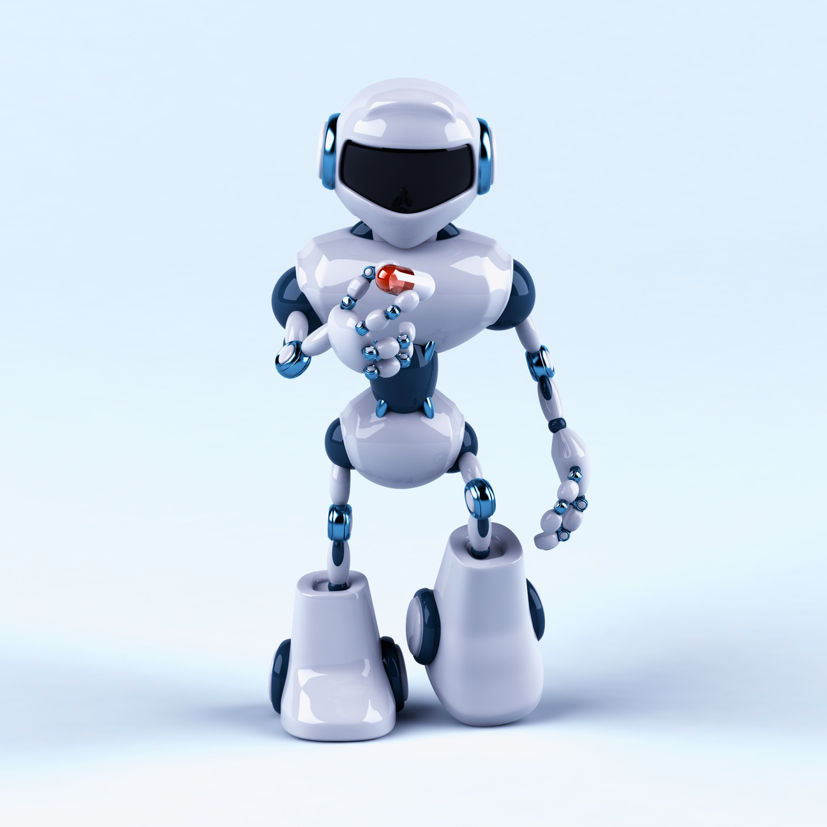
PROJECT OBJECTIVES
  Demystify Algorithms: Transform abstract logic into observable patterns.
  Visual Scaffolding: Demonstrate the relationship between heuristic exploration and path optimality.
  Interactive Learning: Enable users to construct edge-case scenarios (mazes/traps).
Technical Demonstration: Showcase high-performance scientific computing in Python

Slide 3

THE A * ALGORITHM ENGINE
  Core Equation: f(n) = g(n) + h(n)
  g(n): Exact accumulated cost from Start to node n
  h(n): Heuristic estimated cost from node n to Goal.
  Optimization: Uses a Binary Heap Priority Queue for O(log N) node retrieval.
  Guarantee: Returns the mathematically optimal path when h(n) is admissible.

Slide 4
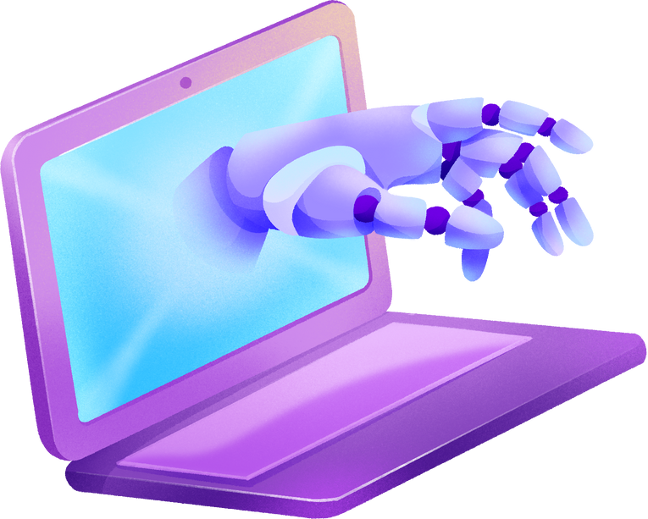
HEURISTICS & TOPOLOGY
  GRID STRUCTURE: 8-CONNECTED GRAPH (MOORE NEIGHBORHOOD).
  HEURISTIC: EUCLIDEAN DISTANCE (SQRT(DELTA X^2 + DELTA Y^2)).
  SERVES AS THE "STRAIGHT LINE" LOWER BOUND.
  GUARANTEES ADMISSIBILITY (NEVER OVERESTIMATES).
  MOVEMENT COSTS:
  ORTHOGONAL: 1.0
  DIAGONAL: SQRT(2) APPROX 1.414

Slide 5

TECHNOLOGY STACK
  Language: Python
  NumPy: Handles the maze as a memory-efficient binary matrix (0 = Free, 1 = Obstacle).
  Matplotlib:
  imshow: Renders the grid state.
  FuncAnimation: Visualizes the step-by-step search process.
  Event Handling: Captures mouse inputs for drawing walls.
01

Slide 6

SOFTWARE ARCHITECTURE
  Design Pattern: Model-View-Controller (MVC) derivative.
  Logic Layer (astar_logic.py): Pure algorithmic functions; no UI dependencies.
  Presentation Layer (main.py): Manages the GUI, event loop, and animation timing.
Optimization Strategy: Decouples the "Solve" calculation from the "Replay" animation to ensure UI responsiveness.
01

Slide 7
VISUAL SEMANTICS
  Black/White Pixels: The Binary WORLD (OBSTACLES VS. PATH).
  GREEN/RED MARKERS: START AND GOAL STATES.
  BLUE REGION: THE SEARCH SPACE (CLOSED SET). REPRESENTS COMPUTATIONAL EFFORT.
  RED LINE: THE SOLUTION. REPRESENTS THE OPTIMAL RESULT.
  KEY INSIGHT: LARGE BLUE AREAS INDICATE "LOCAL OPTIMA" TRAPS WHERE HEURISTICS FAIL.

Slide 8

FUTURE SCOPE
  FUTURE EXTENSIONS:
  Weighted Terrain: Variable traversal costs (e.g., swamp vs. road).
  Dynamic Replanning: D* Lite for moving targets.
  3D Expansion: Voxel-based pathfinding for aerial agents.
CONCLUSION
  SUMMARY: SUCCESSFULLY BRIDGES THEORY AND PRACTICE THROUGH INTERACTIVE VISUALIZATION.
  CURRENT CAPABILITIES: STATIC 2D GRID SOLVING WITH VARIABLE OBSTACLES.

Slide 9

THANK YOU

